Slide 1
Software Configuration Management

Slide 2
Why Is Software Difficult to Build?
Lack of control
Lack of monitoring
Lack of traceability
Uncontrolled changes

Slide 3
Fundamental Sources of Change
New business or market conditions
Changes to SW requirements or business rules
New customer needs
demand modification of data, functionality, or services
Business reorganization
causes changes in project priorities or software engineering team structure
Budgetary or scheduling constraints
cause system to be redefined

Slide 4
Conflicts in Team Software Development
Simultaneous updates – how to prevent one person from undoing the changes of another
Shared and common code – how to notify everyone who needs to know about a change
Versions – how to make changes to all affected versions when needed

Slide 5
Software Configuration Management Basics
Identification – identifying software configuration items in a baseline
Control – controlling the release of a product and changes to it throughout its lifecycle
Status Accounting – recording and reporting of the status of components and changes
Auditing and Reviewing – Validating the completeness of a product and that SCM procedures are being followed

Slide 6
SCM Definitions
Baseline – One or more software configuration items that have been formally reviewed and agreed upon and serve as a basis for further development
Software Configuration Item – A collection of software elements treated as a unit for the purposes of SCM
Configuration – A collection of all the elements of a baseline and a description of how they fit together

Slide 7
SCM Definitions
Configuration Control Board – Group with the responsibility for reviewing and approving changes to baselines
Software – All of the code, specifications, plans, descriptions, processes, and documents associated with a software development effort
Version – A specific instance of a baseline or configuration item

Slide 8
Three Main Types of Release
Baseline versions
Intermediate versions, and
Revisions
They are all quite different and serve different needs.

Slide 9
Baseline Versions
Planned early
Reviewed, tested
These are milestone in the software system’s life cycle.
These are the major releases!
Usually have major changes or upgrades or enhancements.

Slide 10
Baseline
A work product becomes a baseline only after it is reviewed and approved.
A baseline is a milestone in software development that is marked by the delivery of one or more configuration items.
Once a baseline is established each change request must be evaluated and verified by a formal or informal procedure before it is processed.

Slide 11
Baseline - Standard Change Process
Change Request is made
Request is Approved or Denied
"Check Out" the item(s)
Make Changes
Testing or Reviews
formal review of design changes,
regression testing of modules, etc
Review the Change Order
Notify all Dependencies
when baseline change will occur
what changes were made to baseline
"Check In" the new baseline

Slide 12
Template for Baseline Change Requests
Name, Date
Type of change
Goal of making the change
Priority / Urgency
Detailed description of the changes
Expected Effects
Timetable for making changes, testing, release,
Estimated Costs

Slide 13
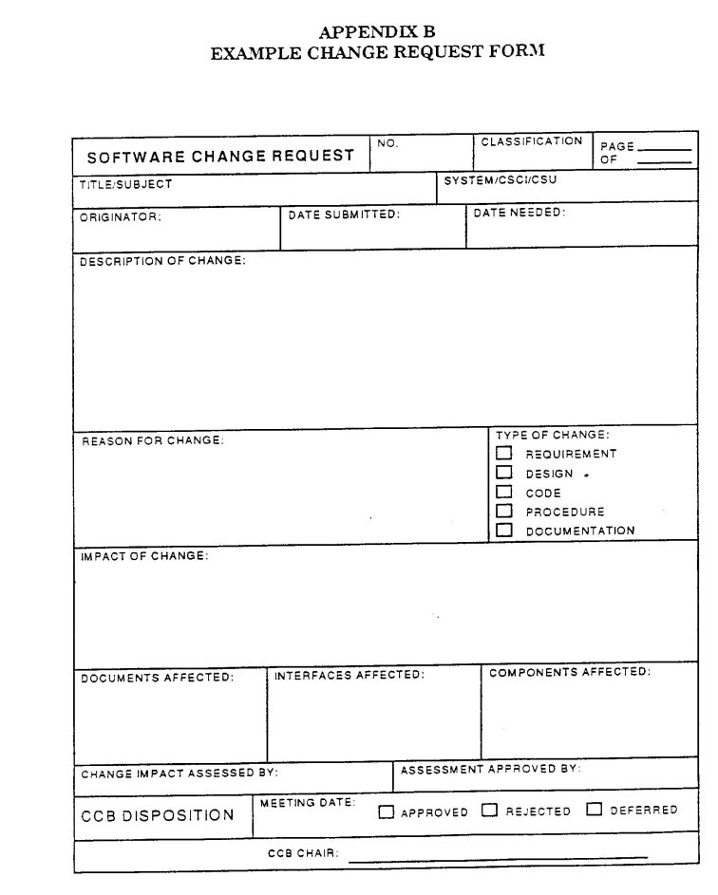

Slide 14
Intermediate Versions
Usually designed to address immediate problems as to correct defects in an important SCI or to include an immediate adaptations for a new customer.
This is an intermediate version of the software.
May be done to serve only a small segment of the firm’s clients; perhaps for a limited period until a new baseline is developed.
Realize that all clients may not be using the same version of software

Slide 15
Revisions
Minor changes and corrections.
May include several small changes in a revision
Sometimes we have several small revisions prior to a major baseline release..
Examples: documentation errors; not show stoppers.

Slide 16
Configuration Management Background
New versions of software systems are created as they change
Configuration management is concerned with
managing evolving systems
Involves the development of procedures and standards to manage product evolution
May be viewed as part of a more general quality management process

Slide 17
Definition
“SCM is the control of the evolution of complex systems,…, for the purpose to contribute to satisfying quality and delay constraints.”
Jacky Estublier
Software configuration management is the discipline of managing the evolution of complex software systems [IEEE STD 1987]
“SCM provides the capabilities of identification, control, status accounting, audit and review, manufacture, process management, and teamwork.”
Susan Dart

Slide 18
Configuration Management Standards
CM should always be based on a set of standards which are applied within an organization
Should define how:
items are identified
changes are controlled
versions are managed
Should be based on an evolutionary process model rather than something like the waterfall model

Slide 19
Standards (approved by ANSI)
IEEE 828: Software Configuration Management Plans
IEEE 1042: Guide to Software Configuration Management

Slide 20
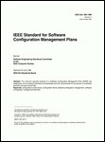
IEEE / ANSI 828
Standard for Software Configuration Management Plans
1. Introduction
a) purpose
b) scope
c) definitions and acronyms
d) references
2. Management
a) organization
b) SCM responsibilities
c) interface control
d) SCMP implementation
e) policies, directives, procedures (naming conventions, version designations, problem report process)
3. SCM Activities
a) configuration identification
b) configuration control (change history, review authority, read/write control, member identification)
c) configuration status accounting (status of change requests, status of approved changes, …)
d) audits and reviews
4. Tools, Techniques, and Methodologies
5. Supplier Control
6. Records Collection and Retention

Slide 21
IEEE 1042
Guide to Software Configuration Management
Defines terms such as baseline and version
Discusses configuration management as a management discipline and its role in the engineering process
Includes checklists of issues for sections of the SCMP (IEEE Std 828)
Includes four complete examples of SCMPs

Slide 22
Families of Application
Main Frame Version
Window Server
Desktop App
Work Station Version
Unix Server
Window Version
Android Version
IOS Version
Base Line
Mobile App
Client
Web App
Server

Slide 23
CONFLICTS
Simultaneous updates – how to prevent one person from undoing the changes of another
Shared and common code – how to notify everyone who needs to know about a change
Versions – how to make changes to all affected

Slide 24
Families of Application
•
•
Users Developers
Main Frame Version
Window Server
Desktop App
Work Station Version
Unix Server
Window Version
Android Version
IOS Version
Base Line
Mobile App
Client
CM
Web App
Server

Slide 25
Software Configuration Items
Computer programs
both source and executable
Documentation
both technical and user
Data
within a program or external to it

Slide 26
Examples of Configuration Items
Product concept specification
Software project plans
Software requirements specifications
Software design descriptions
Source code
Database descriptions
Software release processes
Software test documents
User documentation
Maintenance documentation
etc

Slide 27
Software Configuration Management Tasks
•
Identification
tracking multiple versions to enable efficient changes
Version control
control changes before and after release to customer
Change control
authority to approve and prioritize changes
Configuration auditing
ensure changes made properly
Reporting
tell others about changes made
•
•
•
•

Slide 28
Version Control
Combines procedures and tools to manage the different versions of configuration objects created during the software process
A variant is a different set of objects at the same revision level and coexists with other variants
A new version is defined when major changes have been made to one or more objects

Slide 29
Version Control
Allows different projects to use the same source files at the same time
Isolates work that is not ready to be shared by the rest of the project
Isolates work that should never be shared
Allows software engineers to continue development along a branch even when a line of development is frozen

Slide 30
Version and Release Management
Invent identification scheme for system versions
version numbering
attribute-based identification
change-oriented identifications
Plan when new release is to be produced
Ensure that version management procedures and tools are applied properly

Slide 31




Version Numbering Derivation Structure from Sommerville
V1.1b
V1.1.1
V1.0
V1.1
V1.2
V2.0
V2.1
V2.2
V1.1a

Slide 32
Version Numbering
32 of 21
Item After Modify Build 1 Build 2 Release 1…
Test Plan 0.0.0 (original version)
0.0.1 --> 0.1.0
0.1.1 --> 0.2.0 --> 1.0.0
Module 1 0.0.0 --> 0.1.0 --> 0.2.0 --> 1.0.0
Module 2 0.0.0
...
0.0.8 --> 0.1.0
0.1.1 --> 0.2.0
0.2.1
0.2.2 --> 1.0.0

Slide 33
Configuration Management Activities
Software Configuration Management Activities:
Configuration item identification
Promotion management
Release management
Branch management
Variant management
Change management

Slide 34
Configuration Management Activities (continued)
•
Configuration item identification
modeling of the system as a set of evolving components Promotion management
is the creation of versions for other developers Release management
is the creation of versions for the clients and users Change management
is the handling, approval and tracking of change requests Branch management
is the management of concurrent development Variant management
is the management of versions intended to coexist
•
•
•
•
•

Slide 35
Configuration Planning
A list of scheduled baseline version releases
•
•
A list of SCIs (documents, code, etc.) to be included in each version.
•
A table identifying the relationship of software development project plans and maintenance plans to scheduled releases of new SCIs or SCI versions.
•
A list of assumptions about the resources required to perform the SCMP.
•
Estimates of the human resources and budget needed to perform the SCMP.

Slide 36
Configuration Planning
Defines the types of documents to be managed and a document naming scheme.
Defines who takes responsibility for the CM procedures and creation of baselines.
Defines policies for change control and version management.
Describes the tools which should be used to assist the CM process and any limitations on their use.

Slide 37
Configuration Management Roles
Configuration Manager
Responsible for defining the procedures for creating promotions and releases
Change control board member
Responsible for approving or rejecting change requests
Developer
Creates promotions triggered by change requests
Auditor
Responsible for the selection and evaluation of promotions for release and for ensuring the consistency and completeness of this release

Slide 38
Change Management
Change management is the handling of change requests
A change request leads to the creation of a new release
General change process
The change is requested (this can be done by anyone including users and developers)
The change request is assessed against project goals
Following the assessment, the change is accepted or rejected
If it is accepted, the change is assigned to a developer and implemented
The implemented change is audited.

Slide 39
1. Change Request
Specifies the procedures for requesting a change to a baselined CI and the information to be documented:
Name(s) and version(s) of the CI(s) where the problem appears
Originator’s name and address
Date of request
Indication of urgency
The need for the change
Description of the requested change

Slide 40
2. Evaluation of a Change
Specifies the analysis required to determine the impact of proposed changes and the procedure for reviewing the results of the analysis.

Slide 41
3. Change Approval or Disapproval
•
This section of the SCMP describes the organization of the configuration control board (CCB).
Configuration Control Board (CCB)
Can be an individual or a group.
Multiple levels of CCBs are also possible, depending on the complexity of the project
Multiple levels of CCBs may be specified.
In small development efforts one CCB level is sufficient.
This section of the SCMP also indicates the level of authority of the CCB and its responsibility.
In particular, the SCMP must specify when the CCB is invoked.
•
•
•

Slide 42
4. Implementing Change
•
This section of the SCMP specifies the activities for verifying and implementing an approved change.
A completed change request must contain the following information:
The original change request(s)
The names and versions of the affected configuration items
Verification date and responsible party
Identifier of the new version
Release or installation date and responsible party This section must also specify activities for
Archiving completed change requests
Planning and control of releases
How to coordinate multiple changes
How to add new CIs to the configuration
How to deliver a new baseline
•
•

Slide 43
Change Management
The complexity of the change management process varies with the project.
Small projects can perform change requests informally and fast while complex projects require detailed change request forms and the official approval by one more managers.
Two types of controlling change:
Promotion: The internal development state of a software is changed (by developers).
Release: A changed software system is made visible outside the development organization(by users).

Slide 44
Quality Factors in CM
Configuration Management (CM) ensures that the current design and build state of the system is known, good & trusted.
Some of the key benefits of Configuration Management which enhance quality may also refer as quality factors are given below:
Increased efficiencies, stability and control by improving visibility and tracking.
Cost reduction by having detailed knowledge of all the elements of the configuration which allows for unnecessary duplication to be avoided.

Slide 45
Quality Factors in CM
Enhanced system reliability through more rapid detection and correction of improper configurations that could negatively impact performance.
The ability to define and enforce formal policies and procedures that govern asset identification, status monitoring, and auditing.
Greater agility and faster problem resolution, thus giving better quality of service.
Decreased risk and greater levels of security.
Faster restoration of service

